Slide 1
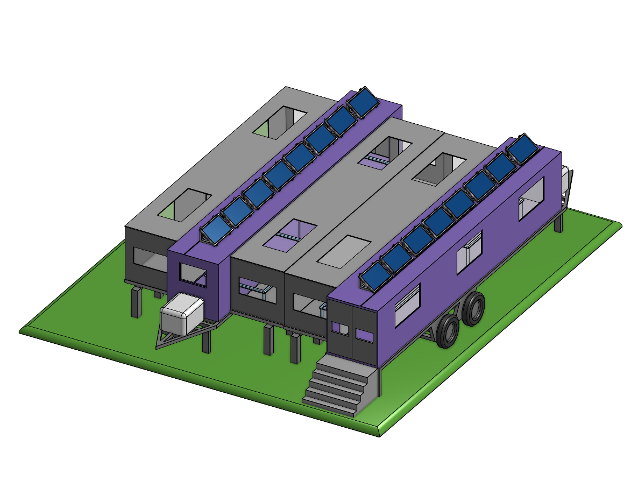

Mobile House Framing
Studio Section 19
Omran Amin, Yicun Guo, Tim Kerkhoff, Arjayn Piratheeparatnam, Tyler Wade

Slide 2

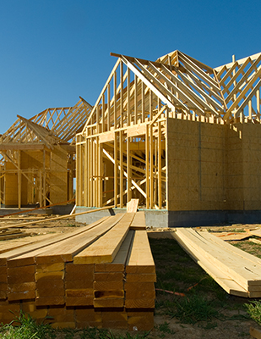
Introduction
Provide a better house framing solution for contractors is our goal.
Obstacles: Infeasible solutions and workload.
More efficient, accurate and environmentally friendly framing solutions are needed.

Slide 3
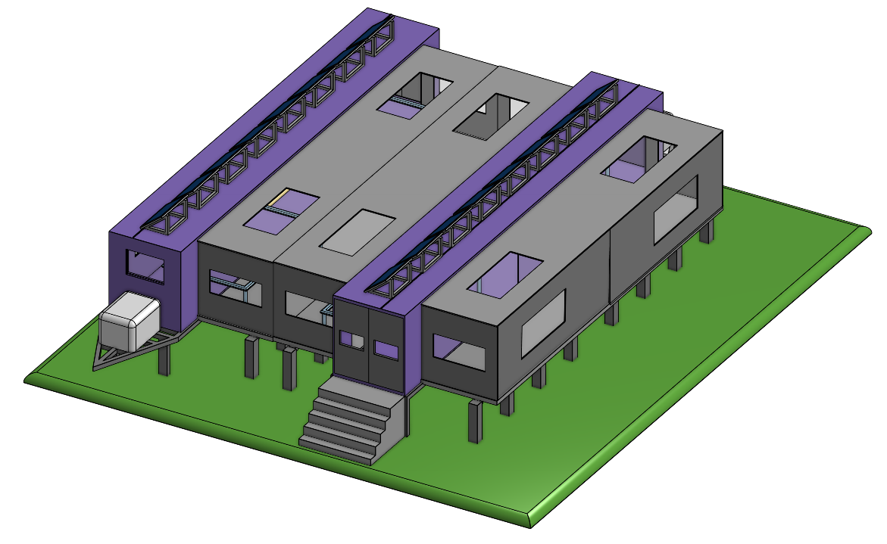
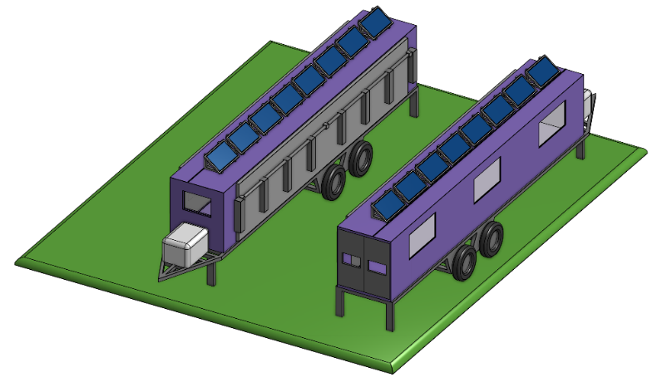
Overview
Double Trailer Plant Style Assembly Method
Portable and Easy to deploy
Increasing Time, Cost, and Material efficiency
Reduce Environmental Impact
Improved Framing Quality
Self-Powered
External Features
Solar Panels
Power Storage
Windows
Folding Support Beams
Security Latches
Trailer Hitches

Slide 4
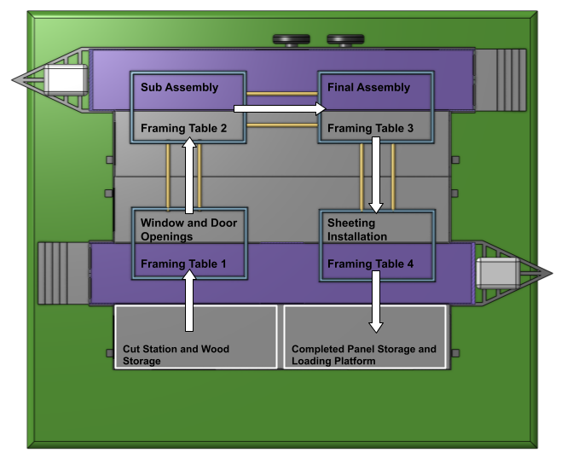
Assembly Process

Slide 5
Team Contribution
How We Arrived To Our Solution?
From our client meeting, we learned about their major concerns (material efficiency, and improved house framing method)
Formed our Needs Statement
Identify the objectives and constraints
Compiling all of our ideas that we found individually, then selecting the best one through Go N0-Go Screening
Found a design that best suits our clients' concerns
Used On-Shape to create our model
Notes:
To develop our solution,
We gained insight from our client to fully understand the problem and form the need statement.
The main objectives and constraints we had to meet, mentioned before, was to improve the frame quality, reduce wasted material, and lower the overall costs.
Preforming screening tests on our ideas lead to our concept of implementing the plant style assembly method at the build site.
To do this successfully, we had to determine the most efficient way of implementing this assembly style while keeping it mobile and simple to operate and relocate.
We wanted to ensure that we adapt the most optimal aspects of other residential construction framing processes and tailored them to the solution that we created. By doing this we ensure that the client and workers are both satisfied and can complete their projects efficiently.
Another task was converting the cargo containers into a work safe environment, as they are lacking the necessary infrastructure, such as lighting, power connections and fire extinguishers. After adding these necessities, we had to make sure the were implemented in a practical way that would not hinder the ability to relocate the trailers when needed.
Only designing the assembly process was not enough, we had to fully design the work environment and ensure it met the required safety conditions, while still being simple and easy to operate and transport. The space required to operate the mobile house framing station had to be considered as well to ensure that it would not be acting as an obstruction to their work when not in use and also making sure that it is not using an excessive amount of space.
Finding solutions to these problems shaped our final design and allowed it to solve our clients problems,
These insights and developments are shown in our 3d model.
Thank you for listening.

Slide 6
Thank You For Listening

